Slide 1
Getting into NODE.JS
A Quick Start Guide

Slide 2
What is NODE?
Node is a free, downloadable java-script library that lets you create a local web-server
This local server can then ‘serve’ web pages to you that are stored on the local computer (as if they were on the Internet)

Slide 3
A Different Kind of Web Page
Unlike regular web pages which are written in HTML, these pages are written in Java-Script
The NODE server will run the Java-Script code from a page every time you request that page to be ‘served’ to the browser.

Slide 4
Program Routes to Follow
NODE is also used with another popular plug-in called “Express.js” which can be used to program routes for your site
A route is just a web-page address and NODE can tell your website which java-script code to run for different addresses that a user types in

Slide 5
Typical Local Web Addresses
With NODE running and a home page created, you can have that page served to you by typing: localhost:3000 in the browser
The :3000 is a port number (kind of like a telephone extension number)
A user might also enter something like: localhost:3000/games and you could program NODE to respond to that request by showing something else instead of a home page

Slide 6
Step 1 – Get Node
A copy of node is available as nodejs_raw
Copy this and rename it to the name of your new site
Open it up and double-click to run the DOS prompt

Slide 7
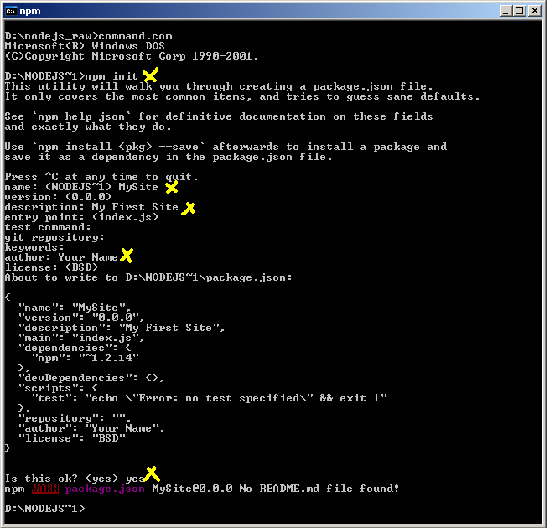
Step 2 – Initialize Your Site
npm init
The wizard will walk you through a few questions
Name your site, give a description and your name
Type ‘yes’ at the end

Slide 8

Step 3 – Add the Express Plug-In
Type the command below. This will download and install the express plugin

Slide 9
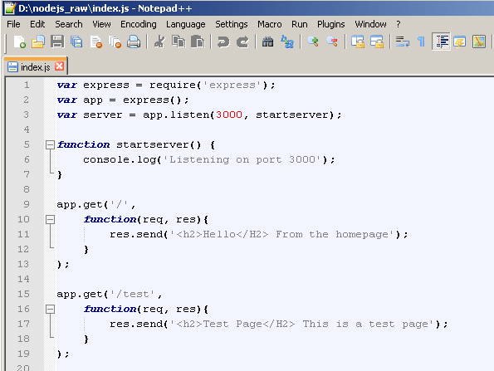
Step 4 – Create Your Main Page (index.js)
Your main page will create a server and define different routes that NODE will respond to when you type in different web addresses
This file defines routes for ‘/’ (home) and ‘/test’

Slide 10
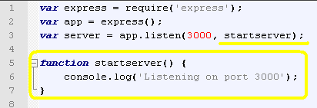
A Closer Look At The Code
The first part creates the ‘app’ and declares that it needs ‘express’
The server then tells the app to ‘listen’ for requests on port 3000 and run the ‘startserver’ function when it starts

Slide 11
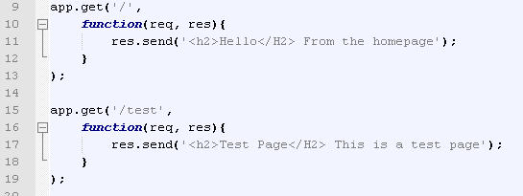
Defining the Routes with app.get
App.get requires the address it should look for, and a function that will run whenever that address is entered
Res.send means ‘send this response’
The home page is ‘/’, and ‘/test’ is also defined

Slide 12
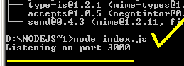
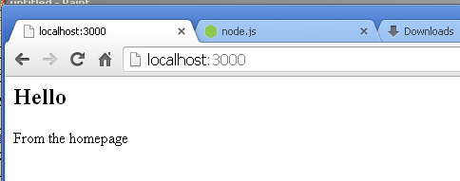
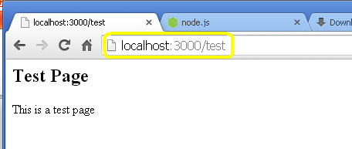
Step 5 – Start Server, try pages
At the DOS prompt, type: node index.js
Then go to your web browser and try the 2 addresses:
Localhost:3000
Localhost:3000/test
Node will ‘serve’ the code back to you, as written in the index.js file

Slide 13
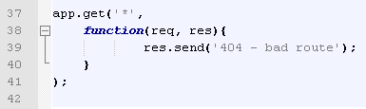
Add a Default Page
At the bottom, you can add a route if no other route has been entered, using *

